Slide 1


Medicaid Analysis
Anita Babic, Melanie Breeding, Nate Esterline, Riya Malhotra, Yajat Mehta

Slide 2


Team Introduction
Nate Esterline
Riya Malhotra

Slide 3


Team Introduction
Melanie Breeding
Yajat Mehta

Slide 4

Team Introduction
Anita Babic

Slide 5


Organization Introduction
Medicaid is a program run by Federal and State governments to provide health coverage to millions of Americans
Provides help to primarily low-income adults, children, pregnant women, elderly adults, and people with disabilities
Each state manages its own program
It serves approximately 83 million Americans

Slide 6

Problem to Solve
Medicaid pharmaceutical costs are rising rapidly, straining resources
High cost, low prescription volume drugsare difficult to identify without clean datasets
Variations across states and drug types create complex spending patterns
Data-driven analysis can help to determine high-cost areas and potential savings

Slide 7
Data Sources
State Drug Utilization Data: https://www.medicaid.gov/medicaid/prescription-drugs/state-drug-utilization-data
All States 2025: https://data.medicaid.gov/dataset/158a1baa-5506-400a-8ec3-97756f0b0536/data
Population 2024: https://www.census.gov/data/tables/time-series/demo/popest/2020s-state-total.html
These datasets include fields such as drug name, national drug code (NDC), reimbursement amounts, state, and most recent population census data.
That makes it the main sources for identifying:
Highest-cost drugs
Utilization patterns
State-level and differences in reimbursement and prescription volume
Population per US state in 2024

Slide 8

Data Tools
Tableau
Data cleaning
Calculated fields
Geographic trend analysis
Visualization segmenting by drug type

Slide 9
STEPS
Step 1 – Data Collection
Medicaid state drug utilization data
2024 state population data
Focused on drug name, state, reimbursement amounts, prescription volume, and units reimbursed
Step 2 – Data Cleaning in Tableau
Cleaned and organized Medicaid reimbursement data
Checked state-level records and drug-level fields
Changed data types for compatibility with analysis building
Step 3 – Calculated Fields
Created reimbursement per capita measures
Compared Medicaid and non-Medicaid reimbursement
Used population data to adjust state-level spending comparisons

Slide 10
STEPS
Step 4 – Drug-Level Analysis
Identified top drugs by reimbursement per capita
Compared high-cost drugs with commonly reimbursed drugs
Identified drugs creating large financial impact despite lower usage
Step 5 – State-Level Analysis
Compared reimbursement per capita across states
Mapped geographic variation in Medicaid spending
Compared total reimbursement against 2024 population
Step 6 – Savings Opportunity Analysis
Used visuals to identify high-cost drugs and high-spending states
Connected findings to possible cost-control strategies
Focused recommendations on targeted drug review and state policy benchmarking

Slide 11
Project Challenges and How We Addressed Them
Communication amongst groups members →
Changed mode of communication and struggled during the semester
Different pages as to what the project will be →
Lengthy discussion and counter-ideas
Picking exactly which tools will be used per analysis →
After receiving the feedback, changed from using python to tableau for the analysis

Slide 12
Anticipated Problems
True cost drivers may be hidden or unmeasured
Data quality issues such as missing or inconsistent records
Complex integration between Medicaid and FDA datasets
High data volume requiring efficient processing
Difficulty mapping drugs into clear therapeutic classes
Challenges isolating true cost drivers beyond total spending
Regional and temporal variability complicates trend analysis

Slide 13
Hypotheses
A small subset of drugs accounts for a disproportionate share of total Medicaid spending
Variation in total spending is primarily driven by either unit price or utilization, depending on the drug category
High-cost specialty drugs contribute more to spending concentration despite lower prescription volumes
Significant geographic variation exists in Medicaid drug spending across states
Differences in state-level spending are influenced by prescribing patterns and reimbursement structures
Medicaid drug spending has increased over time, driven by shifts in drug mix and pricing dynamics

Slide 14
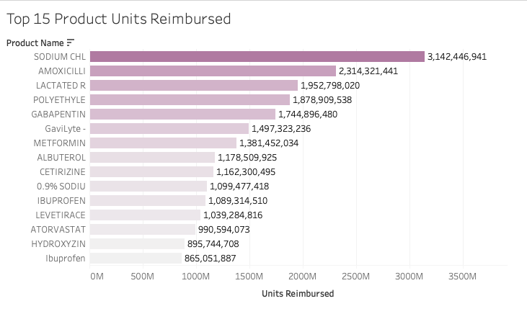
Most Common Reimbursement Units

Slide 15
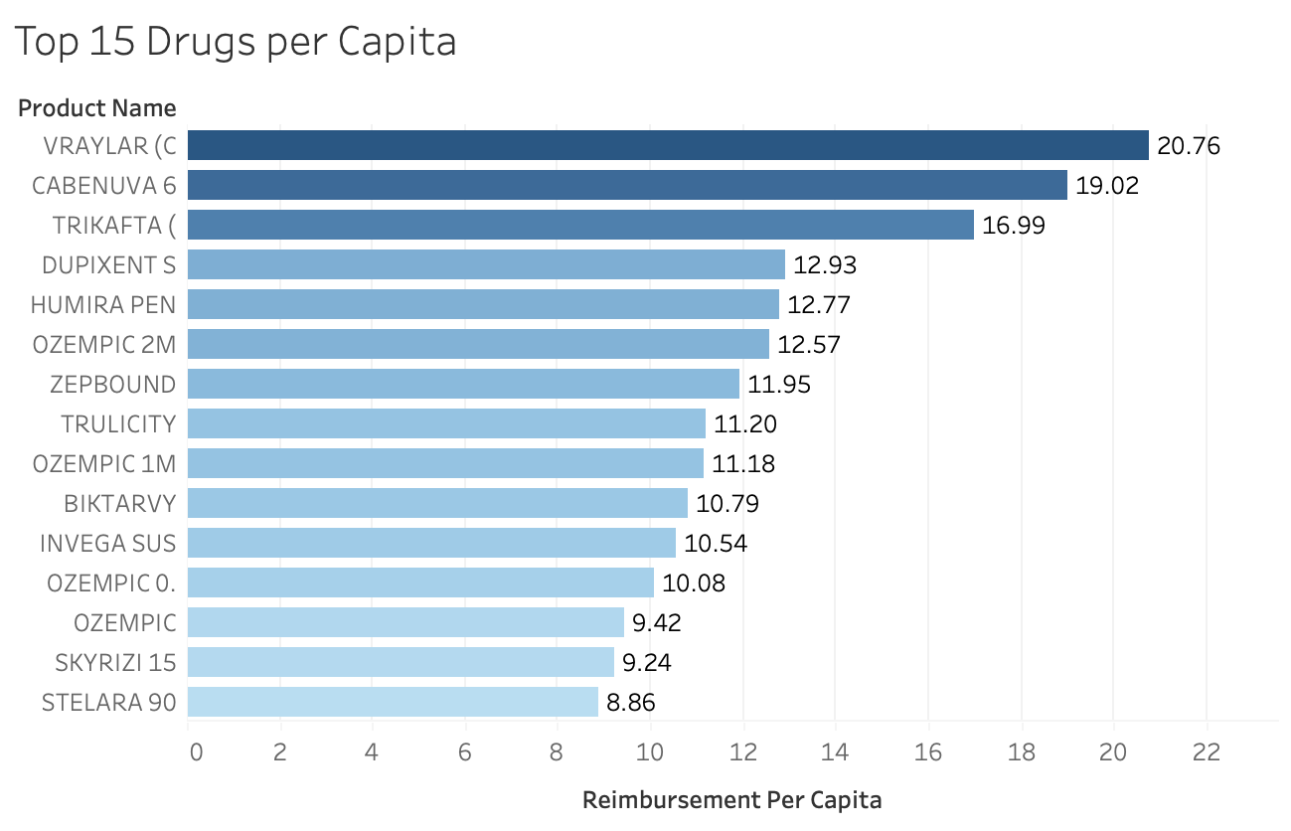
Cost Reimbursement per Drug

Slide 16
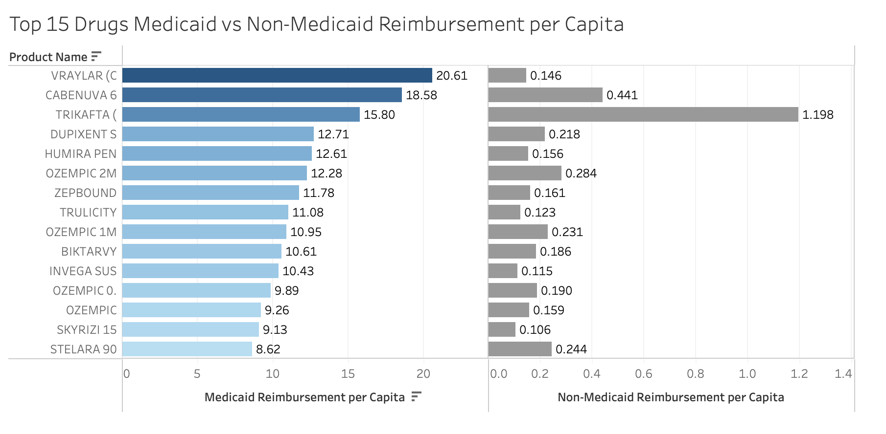
Variation in Medicaid Spending

Slide 17
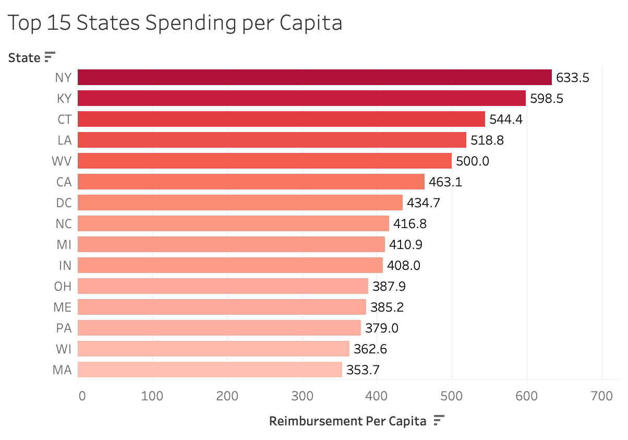
State Cost Drivers per Capita

Slide 18
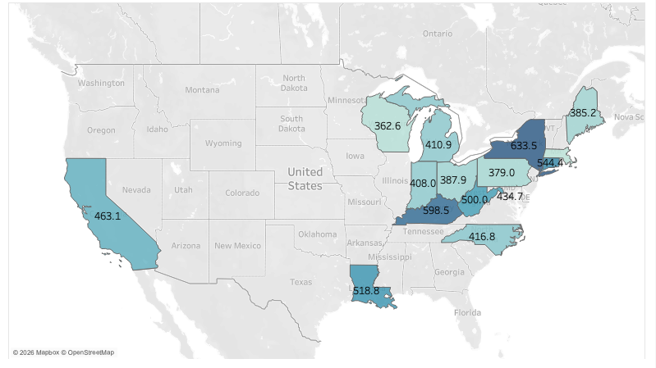

Slide 19
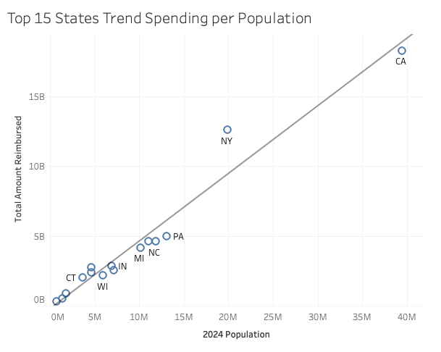
Trend

Slide 20
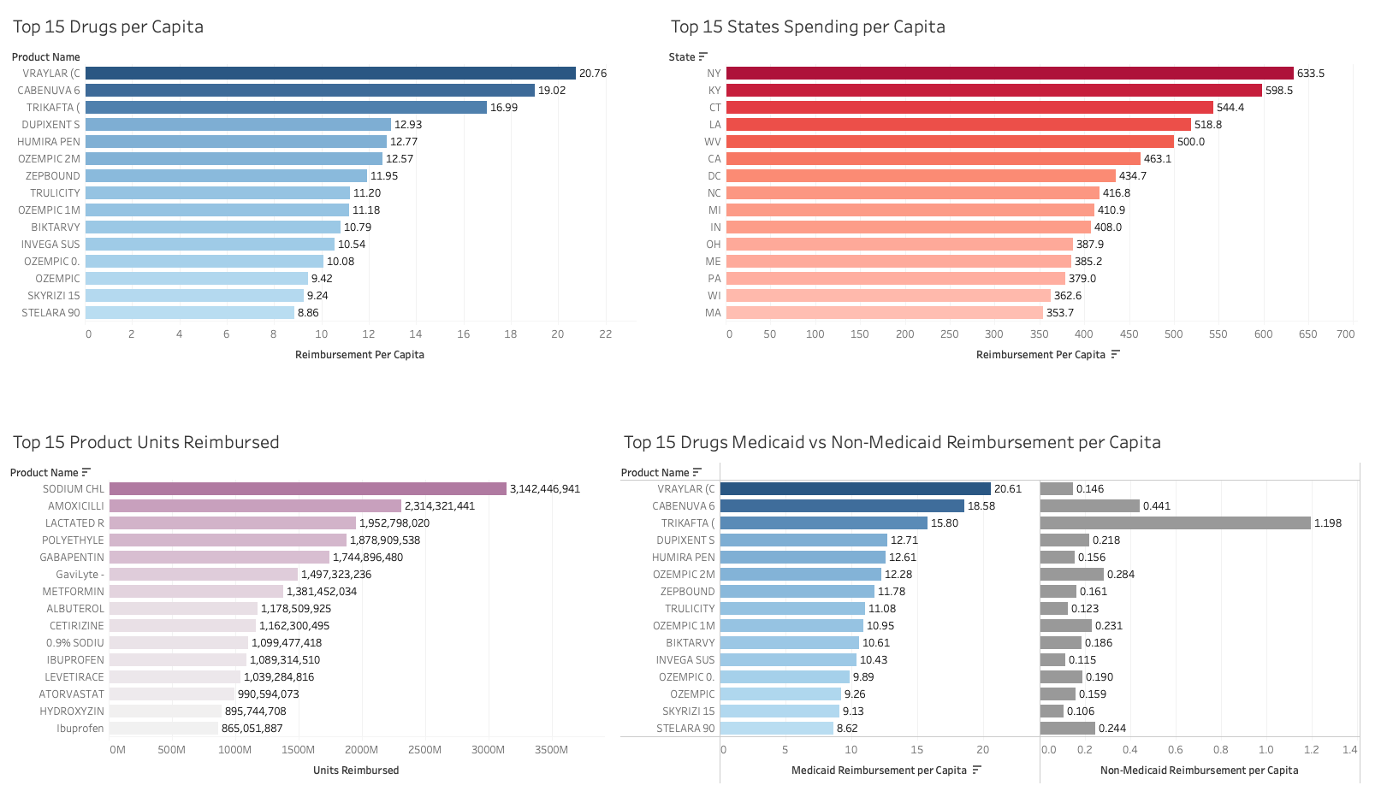

Slide 21
Savings: Target High-Cost Drugs
Medicaid spending is concentrated among a small number of high-cost drugs
The top drug visualization shows Vraylar as the highest reimbursement per capita drug
Cost-control efforts should begin with the highest-cost drugs
Strengthen rebate negotiation, review therapeutic alternatives, and apply prior authorization where appropriate

Slide 22
Savings: Policies
New York, Kentucky, Connecticut, Louisiana, and West Virginia are the top 5 highest Medicaid spenders per capita in the nation
Per capita analysis reveals that smaller states like Kentucky, West Virginia, and Louisiana are carrying costs far out of proportion to their population size
Strengthening oversight of the private health plans managing Medicaid benefits in these states can create accountability for overall spending patterns
State-level policy changes, including managed care reforms and drug utilization review programs

Slide 23
Strategic Implications of Medicaid Analysis
Trends
Strategies
A few specialty drugs drive the majority of Medicaid spend
Prioritize rebate negotiation and prior authorization on top drugs
High-volume drugs are low-cost generics
Target drug cost, not prescription volume
Medicaid bears nearly all costs with minimal cost sharing
Pursue supplemental rebates and payer mix strategies
A handful of states spend far above the national per capita average
Apply state-level policy interventions where return of savings is highest

Slide 24
Why Its Important
Medicaid drug spending is growing and will intensify as new specialty drugs enter the market
Data-driven analysis enables precision cost reduction without cutting patient access or benefits
A small number of drugs and states represent the greatest opportunity for immediate impact
Early intervention through policy reform and rebate negotiation creates long-term sustainability

Slide 25

Conclusion
Medicaid pharmaceutical spending is concentrated among specific high-cost drugs and high spending states
The strongest savings opportunities are targeted drug review, rebate negotiation, prior authorization, and state level policy reform
Medicaid can reduce cost pressure more effectively by focusing on the areas with the greatest financial impact

